Slide 1


Molly Asher¹, Mark Trigg¹, Cathryn Birch², Steven Böing²
1. School of Civil Engineering, University of Leeds,
2. School of Earth and Environment, University of Leeds
Predicting Pedestrian Counts using Machine Learning
Molly Asher¹, Yannick Oswald², Nick Malleson²
¹ School of Earth and Environment, University of Leeds
² School of Geography, University of Leeds
These slides: https://urban-analytics.github.io/dust/presentations.html

Slide 2
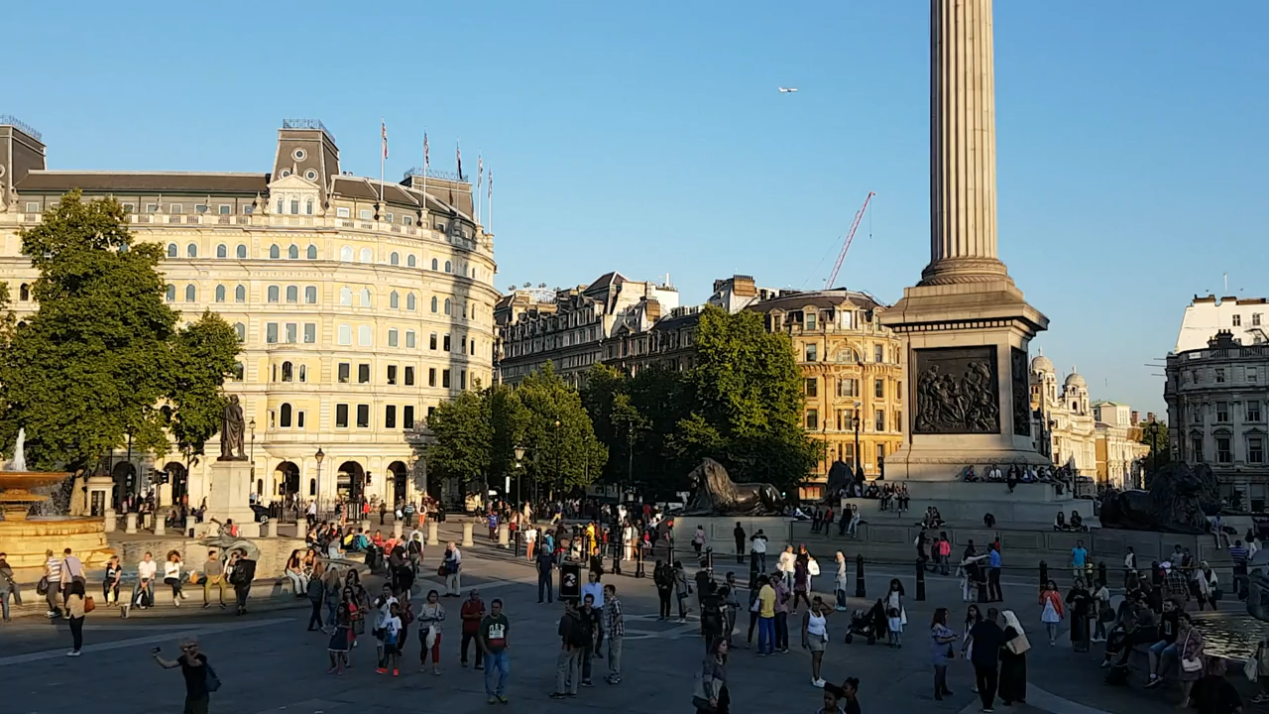
Notes:
Urban environments filled with people
Good data on where they live
Scarce data on how/why/when they move around
Complicated to understand – different kinds of people/doing different things/for different reasons
Understanding movement of people important
Can help us answer Qs:
How can we encourage people into city centres to spend money after COVID?
In which places does pollution cause the greatest harm? (so identifying places which not only have poor air quality but also a lot of people outdoors)
Work aims to to use machine learning to better understand these mobile populations
Urban environments, like the one on screen, are filled with people.
We generally have quite good data on where these people live (from things like the census, council records), but data is much more scarce on how and why and when these people move around the urban environment.
And so this is quite a complicated thing to understand because as there’s lot of different kinds of people, doing lots of different things, for lots of different reasons
But understanding this movement of people is really important, and it can help us to to answer Questions such as:
How can we encourage people into city centres to spend money after COVID?
In which places does pollution cause the greatest harm? (so identifying places which not only have poor air quality but also a lot of people outdoors)
Our work aims to use machine learning to better understand these mobile populations

Slide 3
Context
Molly Asher¹, Mark Trigg¹, Cathryn Birch², Steven Böing²
1. School of Civil Engineering, University of Leeds,
2. School of Earth and Environment, University of Leeds
Accurately predicting number of pedestrians is both important and challenging
Aims and objectives:
This work is using machine learning to:
Better understand the impact of the built environment and other contextual factors on pedestrian counts
Predict the number of pedestrians at un-sampled locations under different conditions
Evaluate the success of past events
Notes:
Skip

Slide 4
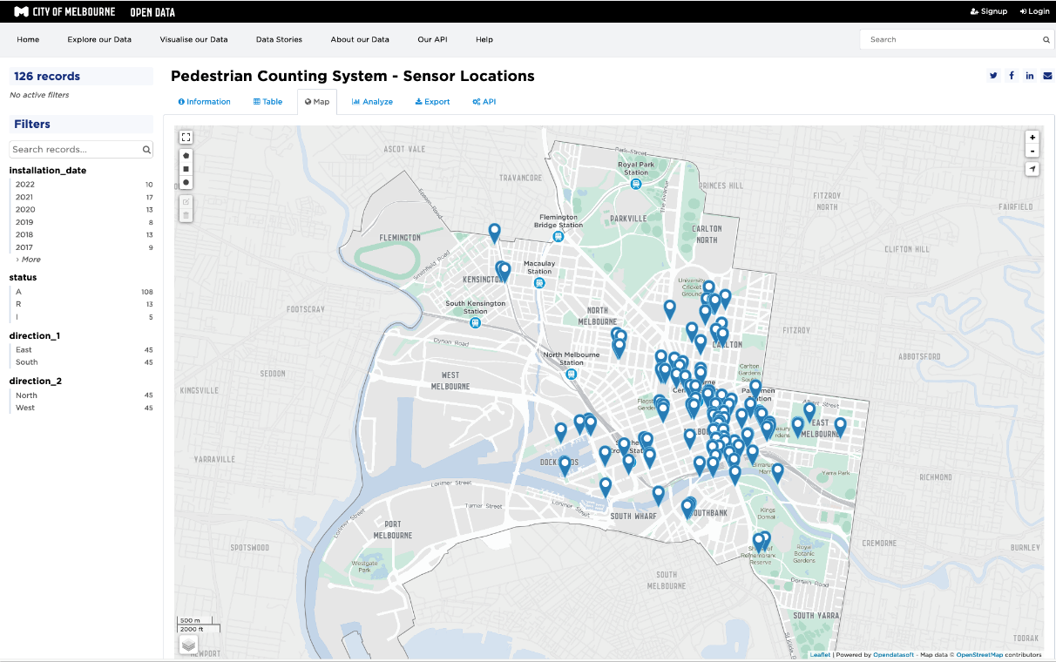
Melbourne Open Data
Molly Asher¹, Mark Trigg¹, Cathryn Birch², Steven Böing²
1. School of Civil Engineering, University of Leeds,
2. School of Earth and Environment, University of Leeds
Melbourne Open Data Portal for open data:¹
Land-use, litter, built environment, roads, bike sharing, air quality, etc.
Network of pedestrian sensors:
18 sensors in 2009
82 sensors in 2022
Record bi-directional pedestrian movements 24h/day every hour
Locations of sensors in the City of Melbourne¹
1 https://www.data.vic.gov.au/discover-city-melbourne-open-data
Notes:
Focus on Melbourne
Has a large amount of open datasets
Crucially: Sensor network
Open/free access to data
15 year record
So for his work, we’ved focused on the city of Melbourne in Australia
We’ve chosen this city because it has a really large amount of open datasets
Most, importantly, a network of sensor that record the movement of people at locations around the city
You can access data freely, and the sensor record goes back 15 years (over which time the number of sensors has gradually increased)

Slide 5
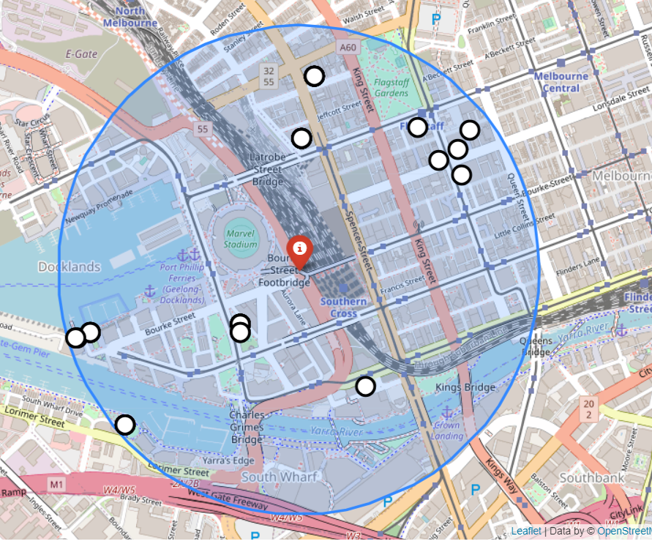
Melbourne Open Data
Molly Asher¹, Mark Trigg¹, Cathryn Birch², Steven Böing²
1. School of Civil Engineering, University of Leeds,
2. School of Earth and Environment, University of Leeds
Numerous additional open data sets, including:
Weather
Street furniture (benches, bins etc)
Buildings
Landmarks
Buffer zones drawn around sensors to link them to features describing urban environment in vicinity
Buffer zone
Sensor
Spatial features
Example buffer zone within which spatial features are linked to sensors
Notes:
Additional datasets – landuse/built environment
Spatial variables linked to sensors with circular buffer
Allows us to investigate influence of urban environment on sensor counts
As I mentioned there are lots of additional datasets available linked to land use and the built environment, so things like types and kinds of buildings and landmarks, street furniture such as benches, bins and street lights, and also weather data.
For spatial variables inked these to the sensors by drawing a circular buffer one around them and counting the number of the different kinds of features within that buffer zone

Slide 6
Modelling Overview
Molly Asher¹, Mark Trigg¹, Cathryn Birch², Steven Böing²
1. School of Civil Engineering, University of Leeds,
2. School of Earth and Environment, University of Leeds
Dependent variable:
number of pedestrians per sensor per hour
Explanatory variables:
time of day (hour, day, month, year)
weather conditions (temperature, humidity, wind speed)
road betweenness (a measure of how well integrated the nearest road is to the rest of the network)
local built environment variables (number of trees, benches, buildings, public transport, etc., etc.)
Trained on available sensor data (4 million rows)
Later used to predict at locations without sensors
Notes:
So combining these datasets we have a depednet variable – the number of pedestrians per sensor per hour,
And our explanatory variables: so the time of day; the weather cnditions; the road betweenness (which describes how well integratedthe nearest road to the sensor is to the rest of the network); and the local built environment varialbes.
So the basic modelling process is to train a model on the available sensor data, and ot then be able to later use it predict at locations without sensors

Slide 7
Model selection
Molly Asher¹, Mark Trigg¹, Cathryn Birch², Steven Böing²
1. School of Civil Engineering, University of Leeds,
2. School of Earth and Environment, University of Leeds
Error metrics
Candidate models evaluated using 10-fold cross-validation
Error metrics (RMSE and MAE) calculated on the predicted counts-per-hour of pedestrians from 10-fold cross-validation of each model against actual values from the sensor data
Model | MAE | RMSE
Linear regression | 268.40 | 370.54
Random Forest regression | 89.88 | 179.62
XGBoost | 121.35 | 207.40
Notes:
Considereded ranfom forest regression and XGBoost and linear regression
Evaluated accuracy using 10-fold CV
Produces predicted count for each sensor, to compare against actual values
Used to calculate error metrics – MAE and RMSE
We considered a couple of different machine learning models to use here, including a random forest regression, Xgboost as well as a linear regression as a comparison.
We evaluated the accuracy of these different models 10-fold cross validation. This process produces a prediction count-per-hour for each data point, which can be compared to the actual values from the sensor data and used to calculate error metrics.
The error metrics used were the mean absolute error and the root mean squared error.

Slide 8
Model selection
Molly Asher¹, Mark Trigg¹, Cathryn Birch², Steven Böing²
1. School of Civil Engineering, University of Leeds,
2. School of Earth and Environment, University of Leeds
Error metrics
Candidate models evaluated using 10-fold cross-validation
Error metrics (RMSE and MAE) calculated on the predicted counts-per-hour of pedestrians from 10-fold cross-validation of each model against actual values from the sensor data
Model | MAE | RMSE
Linear regression | 268.40 | 370.54
Random Forest regression | 89.88 | 179.62
XGBoost | 121.35 | 207.40
Random forest regressor selected as best performing model
Notes:
From this, we identified that the random forest regressor was the best performing model,.

Slide 9
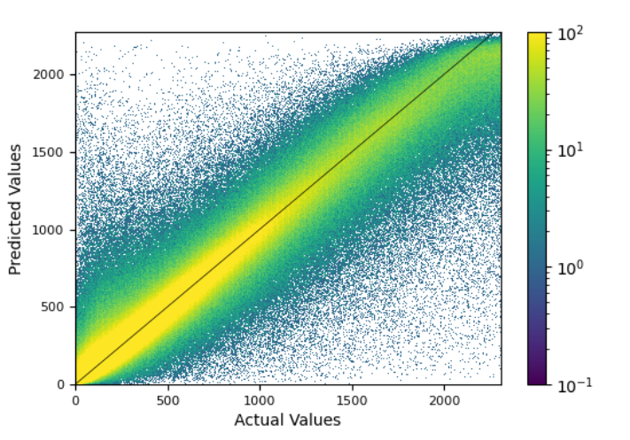
Model evaluation
Molly Asher¹, Mark Trigg¹, Cathryn Birch², Steven Böing²
1. School of Civil Engineering, University of Leeds,
2. School of Earth and Environment, University of Leeds
Random forest regressor
Predicted counts-per-hour of pedestrians plotted against actual values from the sensor data
Most predictions fall around the diagonal (x=y), giving confidence that model is not biased towards smaller or larger counts
MAE | RMSE
89.88 | 179.62
Notes:
More detail on RF predictions
Predicted count agains actual counts
Predictions around diagonal line so not biased
So now I can show in a bit more detail how the predictions from the random forest rergression model compare to the real values in the sensor data.
The plot on the screen now shoes the predicted counts-per-hour of pedestrians plotted against actual values from the sensor data.
Which shows that although the model is of course not perfect, most predictions do fall around the diagonal line, which gives some confidence that the model is not biased towards smaller or larger counts

Slide 10



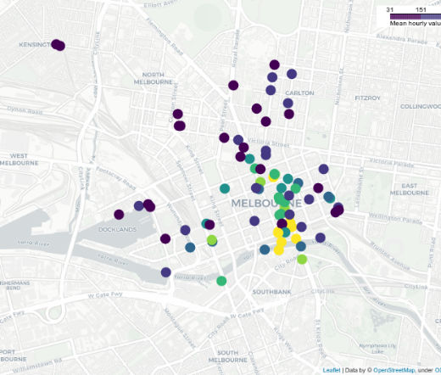
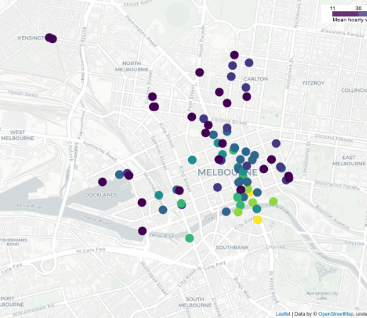
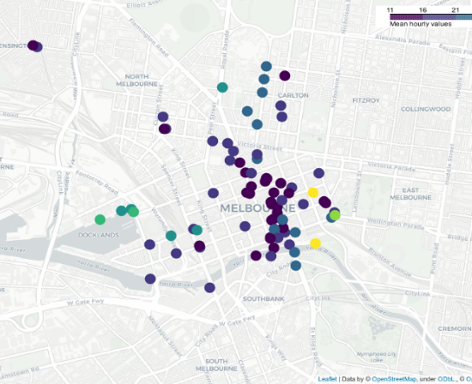
Spatial variation
Molly Asher¹, Mark Trigg¹, Cathryn Birch², Steven Böing²
1. School of Civil Engineering, University of Leeds,
2. School of Earth and Environment, University of Leeds
Mean
MAE
MAPE
Central and southern sensors capture highest footfall
Patterns of absolute error follow (roughly) the mean, with some deviations
Several sensors with much larger percentage error
Notes:
Does model perform equally well in all locations?
Color scale
First: raw data
Second: abs error
Third: % error
We’ve also looked in more detail at the spatial variation in the model’s performance. So whether the model performs equally well in different locations, or if there are some places where it perhaps struggles more.
So, the first panel show the raw data, so the mean values from the observations at each sensor. So can see clustering of higher values in the CBD, and lower values further out
The second, shows the absolute error, where as expected generally the sensors with the higher counts, have the higher absoloute errors, although there is some variation in this which it would be useful to look more into
And the third shows the percentage error, giving a fairer assessment of where the model is predicting poorly.

Slide 11
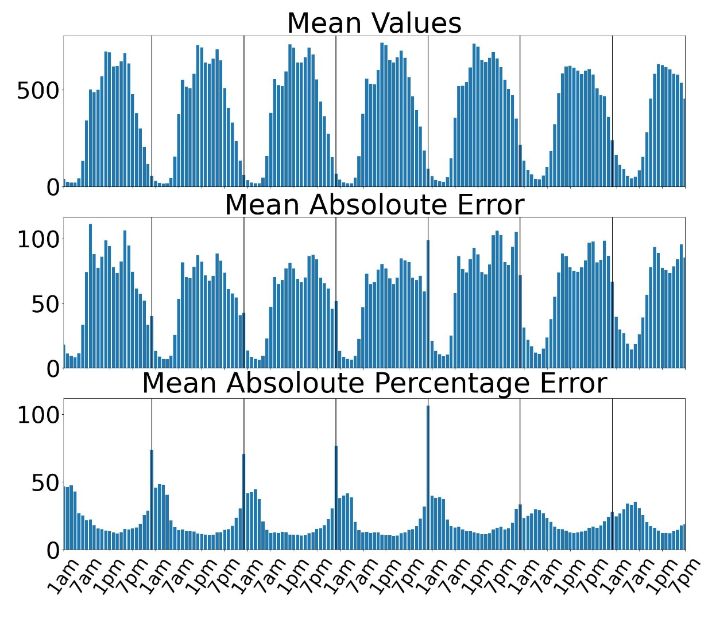
Temporal variation
Molly Asher¹, Mark Trigg¹, Cathryn Birch², Steven Böing²
1. School of Civil Engineering, University of Leeds,
2. School of Earth and Environment, University of Leeds
Reflect typical city centre patterns
Similar patterns to mean (larger counts = larger errors)
Largest errors at night
Notes:
Broken down temporally, so looking at the accuracy of the predictions at different times of day

Slide 12
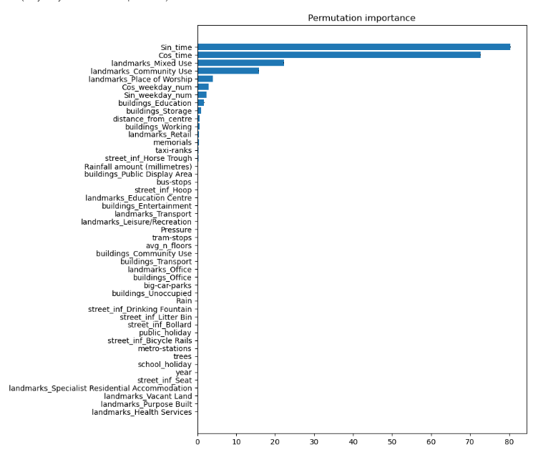
Feature importance
Molly Asher¹, Mark Trigg¹, Cathryn Birch², Steven Böing²
1. School of Civil Engineering, University of Leeds,
2. School of Earth and Environment, University of Leeds
Ranks features contribution to the model’s predictions
Most important features:
Hour of day
Landmarks (mixed, community use, places of worship)
Weekday
Educational buildings
(surprisingly) lower importance features:
Betweenness
School/public holiday
Notes:
Benefit of RF is feature importance
Early stages of analysis
Most important features
Least important
Need to consider more
One of the key benefits of a random forest model is that returns information on the features that were most important for the model’s predictions, which allows us to begin to infer about the nature of the impact of the urban environment on the numbers of pedestrians in a location. We’re at the earlier stages of analysing these results, so its difficult to provide any firm theoretical conclusions. Focusing on the permutation importance on the right, we can see that the features that come out as most important are the hour of the day, unsurprisingly, landmarks, including community use and places of worship, the day of the week and educational buildings. And a couple of feature which come out as not very important which are perhaps surprising, are the betweenness of the road the sensor is nearest to, and whether it was a school or public holiday. So, yeh, will be having a bit more of a think on this going forward

Slide 13
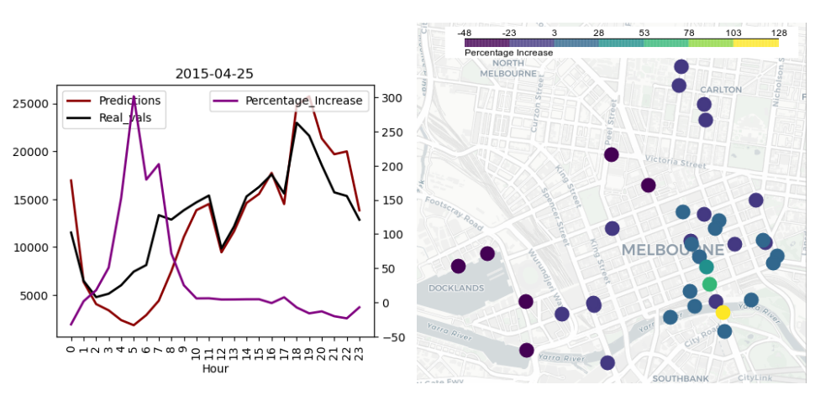
Evaluating events
Molly Asher¹, Mark Trigg¹, Cathryn Birch², Steven Böing²
1. School of Civil Engineering, University of Leeds,
2. School of Earth and Environment, University of Leeds
Model can be used as a tool to evaluate success of events
E.g. Anzac Day Parade:
5% more footfall in whole city over 24h
72% more footfall from 3-10am
128% more footfall at a sensor in south-east near parade location
Notes:
Example use of model
How many more people than expected
Anzac Day example
Total number of people
Temporal structure
Spatial structure
Finish by giving an example of how the model can be used in one way, which is to evaluate the success of events.
So basically using the model to assess how many people would be expected in the city, or in a particular part of the city, at a certain day and time. And using this as a baseline against which to evaluate how many people more than expected attended an event
Th example I’ve given here is the Anzac Day parade, which is a memorial to Australians and New Zealanders who’ve died fighting in various wars.
So considering the total number of people in Melbourne on the day of the parade, we find that there were 5% more people than the model expected
Figure at the top looks in more detail at the temporal structure of this. The purple line represents the percentage increase in pedestrians and shows that the majority of the extra people were in the morning hours, between 3 and 10am
And the bottom plot looks at the spatial picture, and shows that the increase in people is very much concentrated in the south-east of the city.

Slide 14
Conclusions
Molly Asher¹, Mark Trigg¹, Cathryn Birch², Steven Böing²
1. School of Civil Engineering, University of Leeds,
2. School of Earth and Environment, University of Leeds
Ongoing work aiming to:
accurately predict the number of pedestrians in time and space at un-sampled locations under different conditions
better understand the impact of the built environment and other contextual factors on pedestrian counts
Evaluate the success of past events
Model performs reasonably well overall
Some spatial and temporal variations in prediction error
Beginning to make inferences about impact of urban environment
Notes:
TO wrap up:

Slide 15
Molly Asher¹, Mark Trigg¹, Cathryn Birch², Steven Böing²
1. School of Civil Engineering, University of Leeds,
2. School of Earth and Environment, University of Leeds
Predicting Pedestrian Counts using Machine Learning
Molly Asher¹, Yannick Oswald², Nick Malleson²
¹ School of Earth and Environment, University of Leeds
² School of Geography, University of Leeds
These slides: https://urban-analytics.github.io/dust/presentations.html

